Slide 1
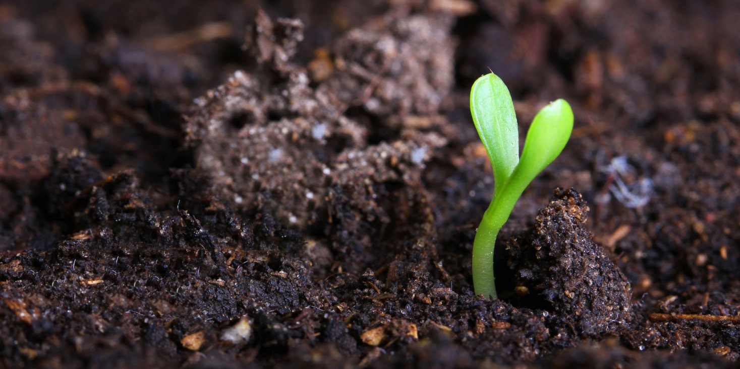
Developing Environmental Vocabularies
Summer Internship 15/16
Xavier Butcher | Vacation Student
12 January 2016
Environmental informatics/land & water
Notes:
Hi I’m Xavier Butcher and I am a summer vacation student at CSIRO Clayton. I am working in the Environmental Informatics team in the Land & Water flagship. Today I will be talking to you about what I’ve been doing for my project – developing environmental vocabularies, and how I’ve done it. I will also introduce you to the concept of online vocabularies and the associated knowledge.

Slide 2
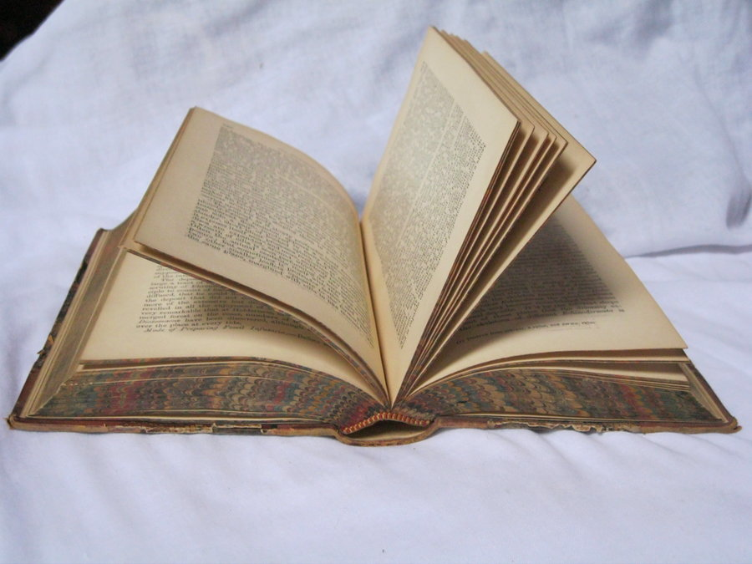
Contents Page
Biography
Introduction
Example
Materials
Method
Results
Key Issues
Specific Issues
Future Developments
Conclusion
Notes:
Just quickly this is what this presentation will outline. *Run through list*

Slide 3
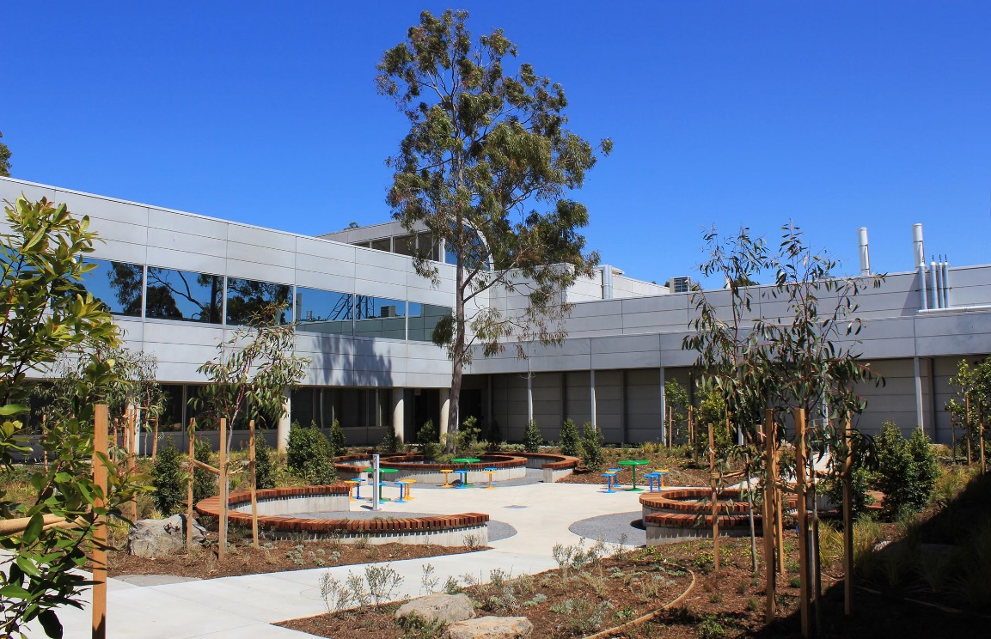
Biography
About me
Why I wanted to spend my summer at CSIRO
Notes:
About Me:
Xavier Butcher
21 years old
Going into 4th year this year
Bachelor of Applied Science (Surveying) (Honours) at RMIT
Why I wanted to spend my summer here at CSIRO:
Gain experience in a renowned scientific research organisation
Previous work experience include BOM and GA
Broaden my horizons into different areas of study
Mandatory 3 month work experience quota
Full time pay is nice

Slide 4
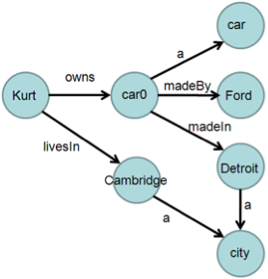
Introduction
Aim & Tasks
What is a vocabulary and why are they important?
SKOS
Semantics
RDF
SPARQL
Notes:
Aim & Tasks
The aim for this project was to create and collate a number of online vocabularies into a standard format and location
There were 4 main tasks relating to this project, which were completed successfully:
Source relevant existing vocabularies
Convert the vocabulary content using semantic web technologies (RDF/SKOS)
Harmonising vocabulary content with existing vocabularies where applicable
Publish vocabularies to SPARQL triple stores where applicable
What & Why
Vocabularies are often hosted online, and are used to support environmental applications. They contain labels, definitions and other related information for a particular concept or registry. This project mostly focussed on land and soil operations. Currently, a number of vocabularies are unique to their individual application, and are often in different formats (text, csv, pdf, or lists). Having a definitive vocabulary on a subject is critical, as the same term could have different definitions or meanings in different vocabularies.
Technical Stuff
These vocabularies follow the guidelines of SKOS, the Simple Knowledge Organization System, which is an industry standard of rules and guidelines across online vocabularies which aims to make publication and use of vocabularies an easy and standard process.
It is also necessary to introduce semantic relationships, which essentially add another layer of detail to vocabulary. This means different terms can be placed in a hierarchical order (broader and narrower), as well as relating similar terms.
RDF is the Resource Description Framework. This is the data model that these vocabularies use. It relies on statements that have a subject-predicate-object (eg “The Sky” “has” “the colour blue”).
SPARQL the SPARQL Protocol and RDF Query Language is, as the acronym suggests, an RDF query language. It is tending to be the industry standard query language. SPARQL allows the user to query semantic data in databases, and retrieve and manipulate RDF data.

Slide 5

Basic Example
Pizza SKOS
Concept of Margherita Pizza
Label, URI and definition
Hierarchy
Related
Collection
Notes:
This example will centre on the ‘Concept’ of a “Margherita Pizza”. As a bare minimum, a Concept must have a Label (Margherita Pizza), a URI (Unique Resource Identifier – a unique web address where the concept can be located) and a Definition (Margherita Pizza is a flatbread generally topped with tomato sauce and cheese and baked in an oven). A Concept may also be part of a hierarchy of other Concepts. In this case, “Margherita Pizza” is a Narrower Concept of “Pizza”, which itself is a Narrower Concept of “Food”. A Concept can also be related to other concepts regardless of hierarchy, for instance “Margherita Pizza” is related to “Mushroom Pizza” in the sense that they are both pizzas that have cheese and sauce. A Concept can also be part of a collection. For example “Margherita Pizza” can belong to the “Vegetarian Pizza” collection.

Slide 6
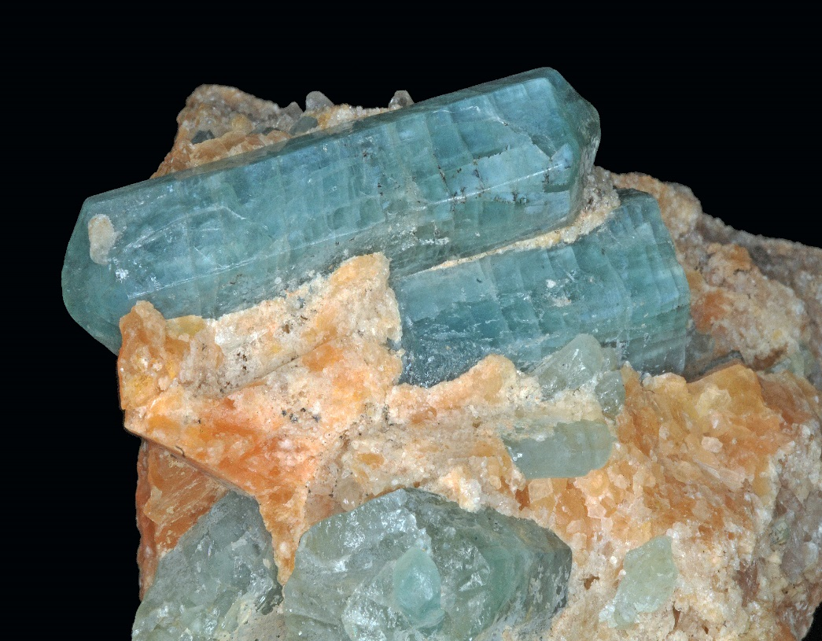
Materials
Australian Soil and Land Survey Handbook (Yellow Book)
Soil Information Transfer and Evaluation System (White Book)
Environmental Informatics Wiki’s
Linked Data Registry (LDR)
Microsoft Office
Notepad++
TopBraid Composer
RDF123
Microsoft SQL Server Management Studio
Notes:
Refer to my report for full references. *Read List*

Slide 7
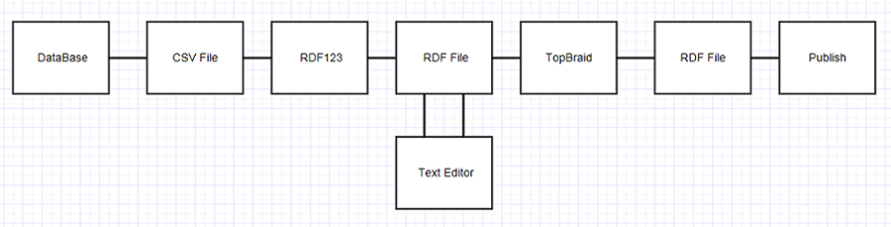
Method
Pre-Reading (articles, journals and wikis)
Microsoft SQL Database (natsoil)
Notes:
Creating vocabularies is a complex process. I created this flowchart and the following step by step method and published it on the wiki page so that future interns or indeed anyone at CSIRO can follow my method.
Long Method: Read from report
Short Method:
This an abridged version of my full method which can be seen in my report.
The first thing step is to do a lot of background reading. There are a number of documents, papers, manuals and wiki’s online that are very useful at getting you up to speed on vocabularies. Next, the soil related data you need can be found in the CSIRO natsoil database. This is viewed on Microsoft SQL Server Studio. Here, a collection of tables are kept which you can export as a CSV.

Slide 8
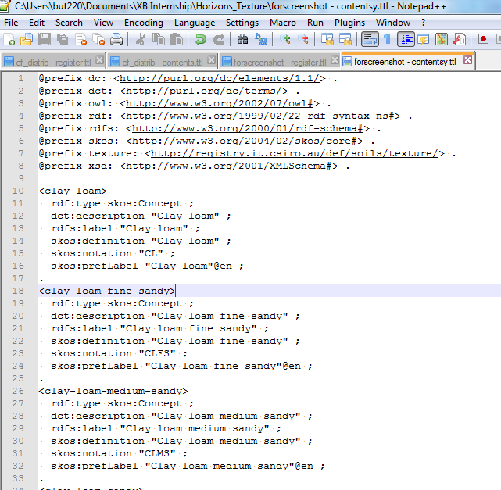
Method
Microsoft Excel (CSV)
RDF123 (RDF editor)
notepad++ (Text editor)
TopBraid (Semantic web modelling)
notepad++ (Post processing)
Publishing (LDR)
Notes:
Following this, you can open the CSV in Excel. This is where you will need to create and modify columns that will capture all of the properties you wish to maintain in the vocabulary. The most common manipulations will be the creation of a URI and the creation of a Label/Definition. Subsequently, you can import this CSV file into RDF123. This program essentially converts your tabulated data into an RDF format. This is also where many of the links between the data are created. After a quick tidy up in Notepad, you can import the file into TopBraid. TopBraid is a program that lets you create semantic relationships and add further necessary properties to make the vocabulary function better. Finally, after another tidy up in Notepad, you are ready to publish to the registry.

Slide 9
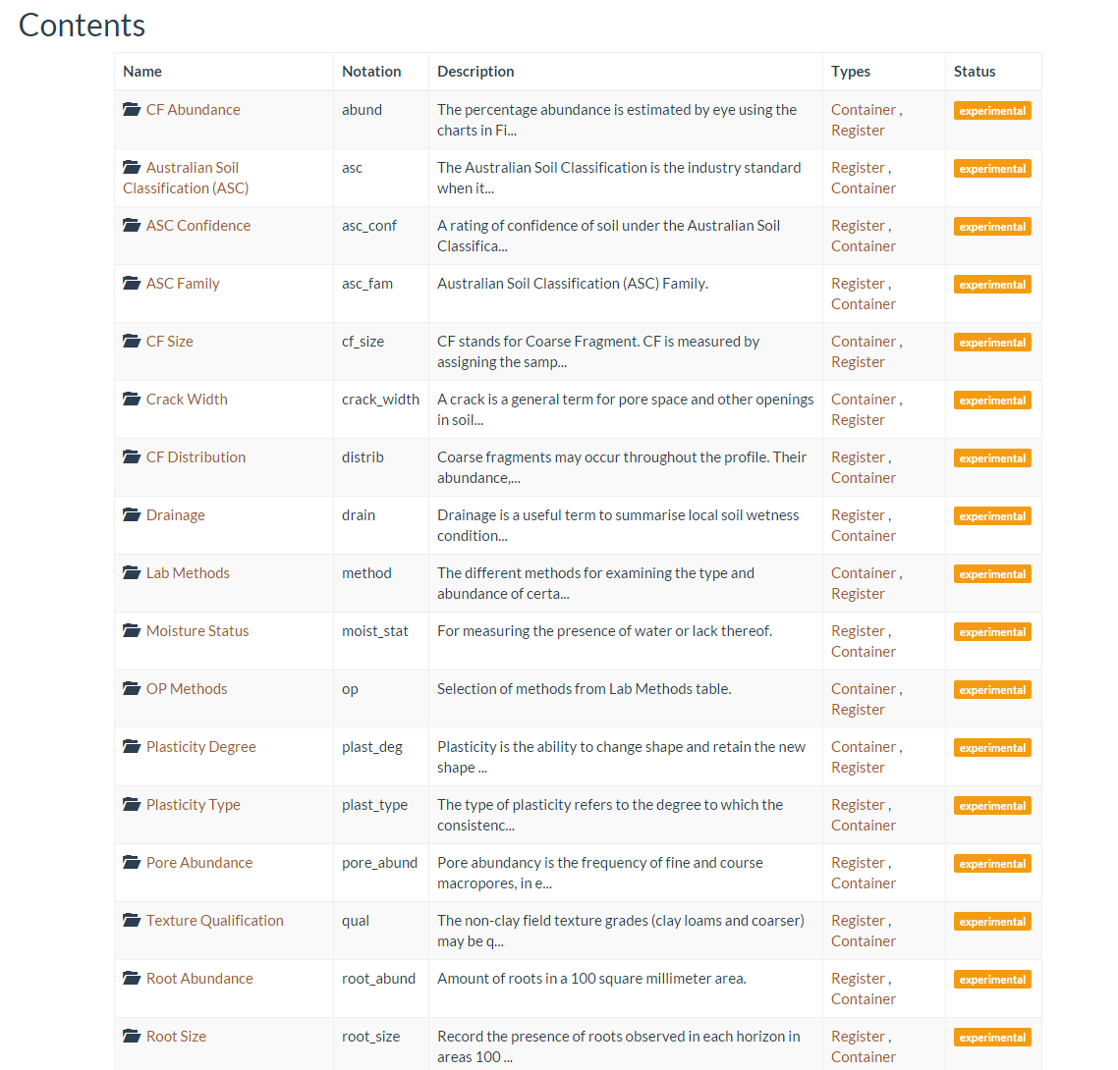
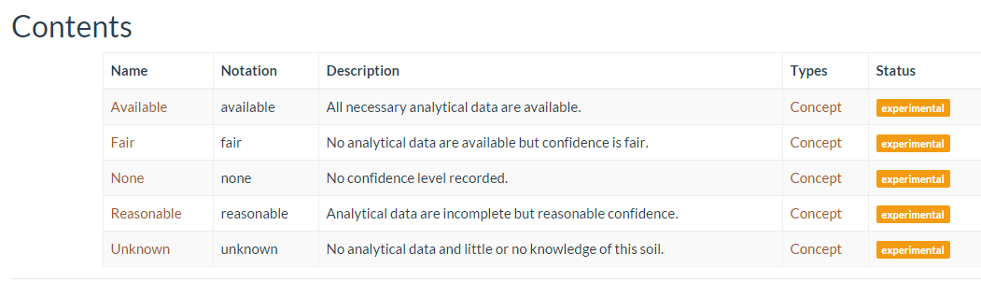
Results
Notes:
All up I have published 27 soil related vocabularies and counting.
The top image shows a few of them. They are stored as registers or containers. Each one of those registers contains a set of concepts, which can be seen in the bottom image.
These vocabularies are up on the CSIRO registry and can be accessed by anyone. So if you ever need to look up the confidence levels of the Australian Soil Classification, you’ll know where to find it!

Slide 10
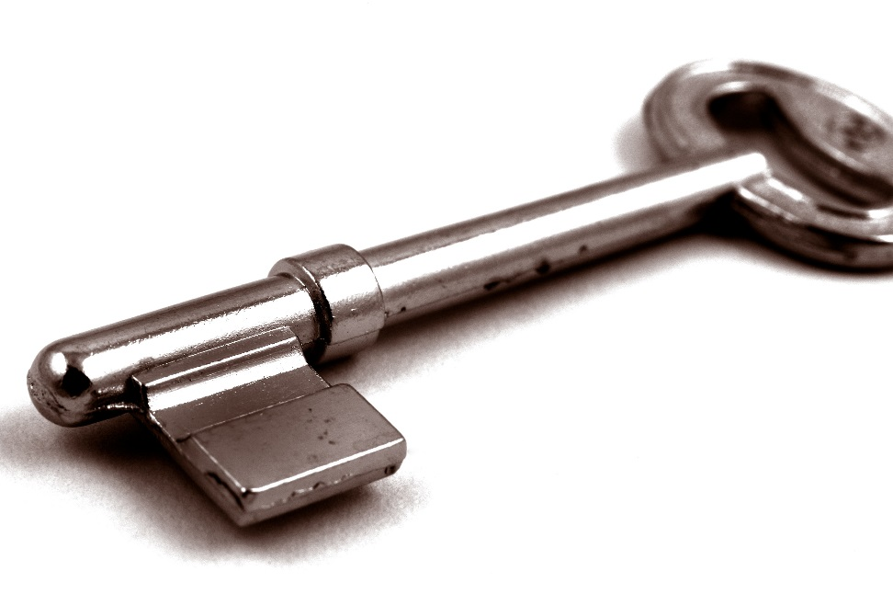
Key Issues
Tabs instead of Commas
Prefixing
@en Label
Denoting range
Copyright
Notes:
When exporting from CSV to RDF123, some CSV files inexplicably exported as Tab Separated Values instead of Comma Separated Values. This is means RDF123 won’t be able to read it. All that is needed to fix it is opening the CSV in notepad, and using the find and replace function to replace tabs with commas.
When trying to get TopBraid to prefix a URI, often times it would not prefix correctly because of an extra slash at the end of the URI. I don’t know how this error comes about, but its easy enough to fix – just delete the slash.
When adding the @en tag to a prefLabel, it is supposed to sit outside of the quotations of the label itself. However RDF123 recognises the whole thing as a label and puts it in quotations. There is no permanent fix I can see for this as that is how the software was designed. The temporary fix is just using the find and replace function in notepad to remove them.
Some vocabularies had information regarding the range of the field. For instance Crack Width. The issue was how to store that information in a vocabulary. I chose to use the xsd:minInclusive and xsd:maxExclusive properties, but it is possible there is a better solution.
The issue of copyright must also come into consideration. Many of the definitions of the concepts were taken verbatim from the soil handbook, so permission must first be granted by the publisher before this can proceed.

Slide 11
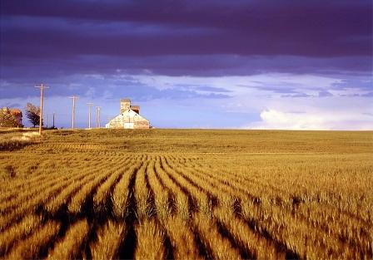
Key Issues
LDR Notation
Longer definitions
Identical Tables
URI Location
Notes:
In the LDR, for some reason the system would take the arbitrary notation I had used and make that part of the URI instead of the proper name I had given it. Eg: http://registry.it.csiro.au/sandbox/student/xavier/abund instead of /cf-abundance.
There were times when I needed to add in a missing definition of a particular method or element or concept. Having done no work on soils, and only a mediocre chemistry and physics background, this was challenging – even if complex textbooks were available.
There were some instances where 2 tables had identical or very similar data. I chose to merge these tables where feasible as this not only creates less work for me, but is much more concise and causes less confusion.
There is also an issue with URI location. My vocabularies were initially stored in a sandbox registry – in case the intern stuffed something up. There was some confusion about whether I should be pointing the URI of an object to the current sandbox location, or to the anticipated true location. I chose the anticipated final location.

Slide 12
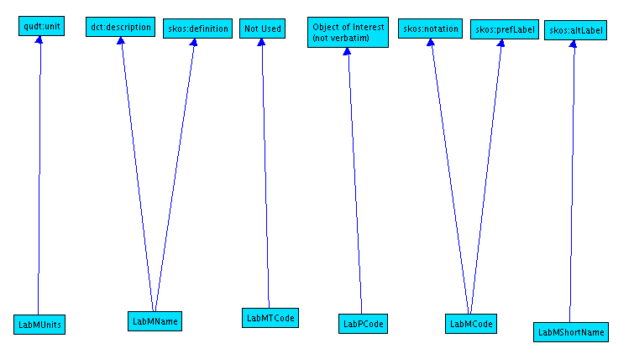
Specific Issues – Lab Methods
Most complex vocabulary
Columns added to CSV
Unique code for each method
Classifying each method into an object of interest
Sorting these into collections
Ideal prefLabel?
Units of measure
Add similar method properties
Mapping
Notes:
Lab methods is the most difficult vocabulary I had to create. It has around 600 data entries across several columns. However, the number of fields that classified the data was not sufficient. So I had to add in several more to get a functioning vocabulary. These included Full Name and Object of Interest.
The biggest issue with Lab Methods was the fact that the only unique identifier was a random arbitrary code. This is not user friendly at all. So for each of these 600 entries, I created a unique identifier. This was done by taking the object of interest of each method, and assigning it a number. Eg: Aluminium-1. I chose this method because I figured that a common use of the vocabulary will be for if a user wants to know all of the different methods of measuring aluminium.
Because that is the aim I’m looking to achieve, the best way to classify these is not only by URI, but to organise these into collections of object of interest. These collections make it easy to search and navigate to this information.
I decided to use the arbitrary lab code as the prefLabel, which I feel is only a temporary solution. I do not yet know how the domain manager would like to classify it, but I would recommend some new label that caters to people who want to search by name as well as those who want to search by lab code.
There was also the issue of units of measure. There were 2 measures that did not have any vocabulary reference anywhere online. So I had to create these and add them to the environment database.
Another property I added was op:method. This is so users can search by method type rather than object of interest. Eg: Volumetric Analysis.
As requested, I created a diagram showing which fields from the database mapped to which fields in the final vocabulary. This is important as a check to make sure all information is transferred.

Slide 13

Future Developments
Database entries
Full automation
RDF123 Replacement
Notes:
I thought it would be a good idea to outline where I think future developments and ongoing work could exist based on the project I’ve already done.
The first thing that needs to happen is to get the online database up to scratch. There are 185 tables in the reference book, but only around 30 of these are in the database. If my project is to be continued on, this needs to happen.
Secondly, the process of creating a vocabulary from a database, whilst difficult to learn initially, is rather repetitive in nature. I would recommend that a computer coder (perhaps in the form of another intern) be brought in to create a script to automate this process. I feel the process should almost certainly be able to be automated, and if it is possible, will allow for efficient conversion from database to vocabulary. The script could also be used for other domains outside of soil, as the process is generic.
Finally, the worst piece of software to use in this process is RDF123. It is not very user friendly, and there are many issues with it that hinder what I am trying to do such as the @en tag I mentioned before – and not to mention the spontaneous freezing of the application. I would recommend that another project could be to create a newer, more stable, more user friendly and efficient program to create RDF files from a CSV.

Slide 14

Conclusion & Acknowledgements
What I’ve learnt
Presenting to colleagues in Canberra
Thanks to:
Jonathan Yu
Simon Cox
Bruce Simons
Luis Neumann
Notes:
This project has been very helpful in developing my skills on informatics technology and helping me understand what is it the Environmental Informatics team do. I have learnt all about vocabularies, SKOS, RDF and even a bit of SPARQL. I also learnt how to use a few new programs like RDF123 and TopBraid. This project has definitely broadened my horizons. I have seen that some of the skills learnt on my time here will be very relevant to my future endeavours. I hope that my work is useful to CSIRO in some way, and that it either gets applied or at least reviewed. I am proud of the quality and quantity of work I have achieved during my internship.
I was fortunate enough to meet and present to my colleagues in Canberra over a few days in January. This was a great experience, and gave me good exposure to see what other activities Land & Water do.
I would especially like to thank Jonathan Yu, Simon Cox and Bruce Simons for their continuous input and guidance on this project. Their help was much appreciated, and I’m sure that they are very much looking forward to not having to answer my rudimentary questions or verifying my SPARQL code. I would also like to thank Luis Neumann for helping with all the initial induction documents and general administration throughout the internship. Lastly of course, I need to thank Section Leaders, Branch Heads and Recruitment for allowing me to undertake this internship.

Slide 15
Thank you – Questions?
Land & Water/Environmental Informatics Vacation Student
xavier.butcher@csiro.au
Environmental Informatics/Land & Water
Notes:
Thankyou – Any questions?

